Slide 1



DATA VISUALIZATION
Mid Term and Final
NAME OF PROJECT:
PRESENTED BY:
Mid Term and Final for Data Visualization
Vu Thanh Dat - 523V0015
Pai Hein Kyaw - 523K0078

Slide 2


1 | Introduction
2 | Exploratory Data Analysis (EDA)
3 | Probability Distribution Analysis
4 | Hypothesis Testing
5 | Correlation Analysis Between Variables
6 | Multiple Linear Regression
7 | Conclusion
Agenda

Slide 3

01
Dataset and Purpose Student success relies on factors like study habits, well-being, and family environment. This report analyzes the Student Performance Factors dataset to explore how these variables impact academic achievement.
02
Preliminary Analysis The study starts with exploratory data analysis to clean the data and visualize key patterns. Probability assessments and hypothesis testing follow to examine significant differences across various student groups.
Introduction
Introduce the project. Provide a quick background and rationale. Briefly share its overall scope as well as expected outcomes.
03
Predictive Modeling Finally, correlation analysis and multiple linear regression models identify the strongest predictors of performance. These findings aim to support better, data-driven decision-making in education.

Slide 4


Exploratory Data Analysis (EDA)
Goal # 1
Goal # 2
Goal # 3
Summarize the Dataset Information
Descriptive Statistical Analysis
Detect Outliers

Slide 5

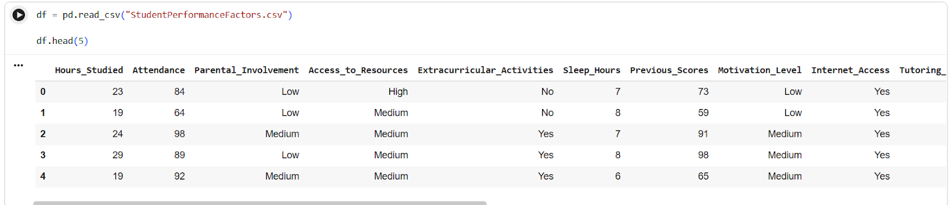
Summarize the Dataset Information
The Student Performance Factors dataset was first examined to understand its structure and content. Using functions such as df.info(), df.head(), and df.shape, the following characteristics were identified: Number of records, Number of variables, Data types(Numerical variables, Categorical variables), Missing and Duplicate Data
Showing the top 5 rows in the dataset for example

Slide 6
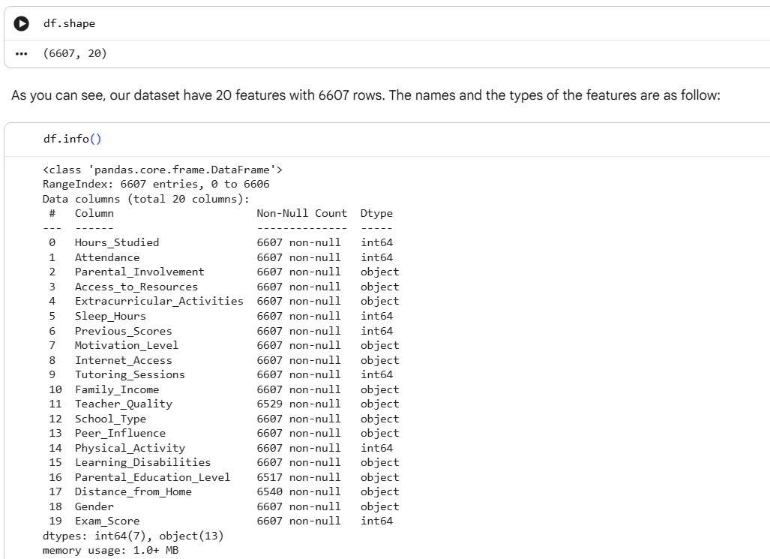
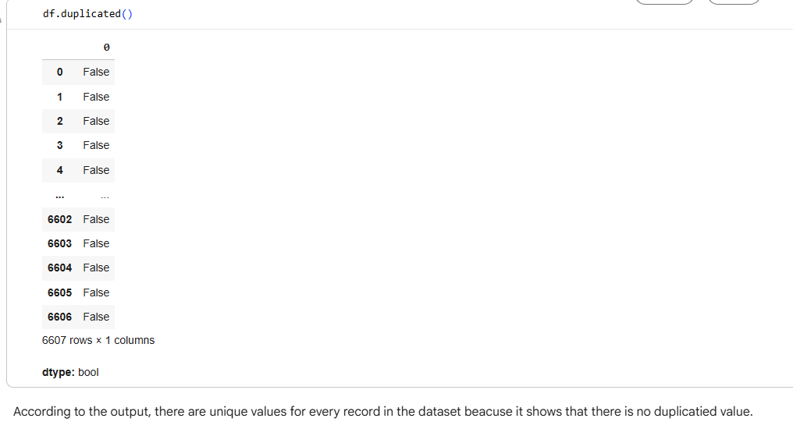
getting the number of records, features and its information
Checking duplication of the entries

Slide 7
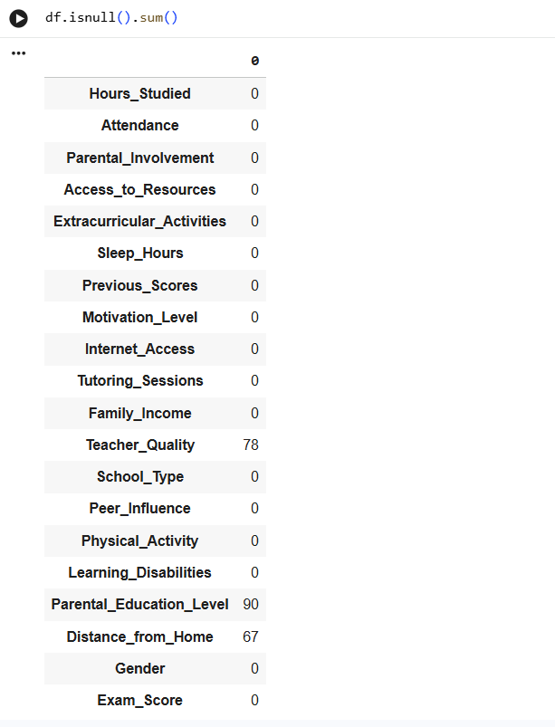
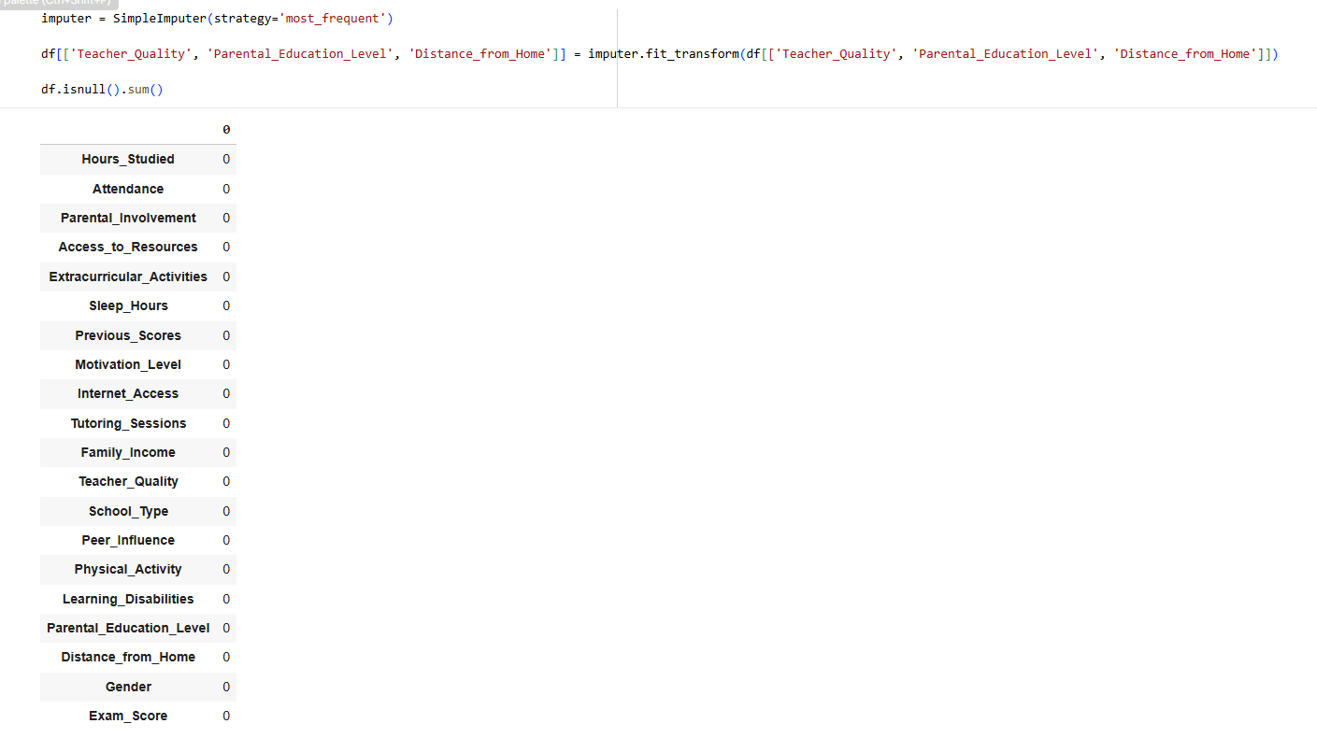
Filling the most frequent to the missing values
Checking null values in the dataset

Slide 8
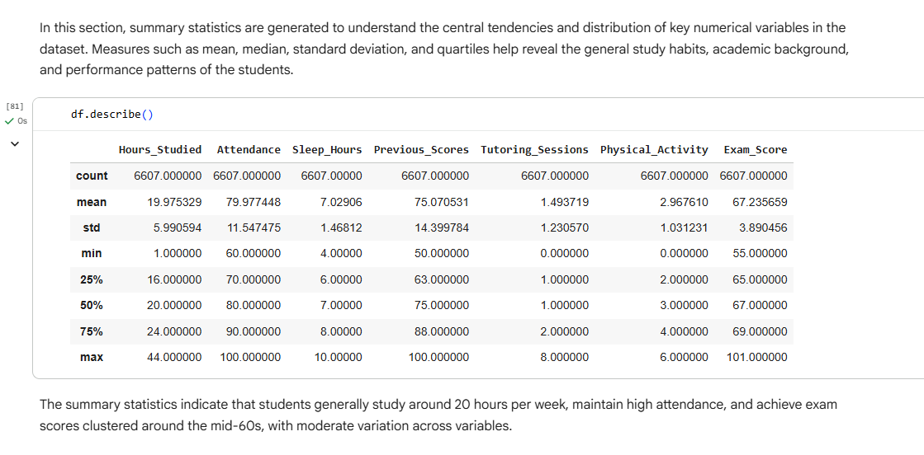
Descriptive Statistical Analysis
To understand the statistical characteristics of each numerical variable, the following measures were computed using df.describe(): Mean and Median, Standard Deviation, Minimum and Maximum, Quartiles (Q1, Q2, Q3)
Getting the statistical characteristics of each numerical variable

Slide 9
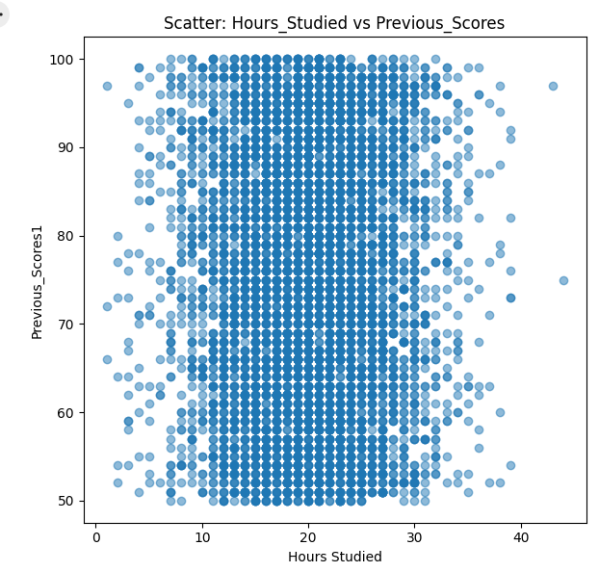
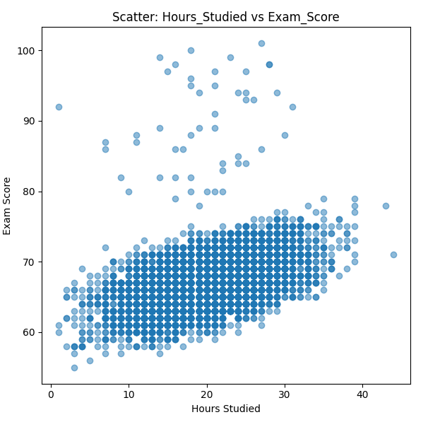
Scatter Plot 1: Hours Studied vs Previous Scores
Scatter Plot 2: Hours Studied vs Exam Score
Scatter plot for Hours Studied vs Previos Scores
Scatter Plot for Hours Studied vs Exam Score

Slide 10
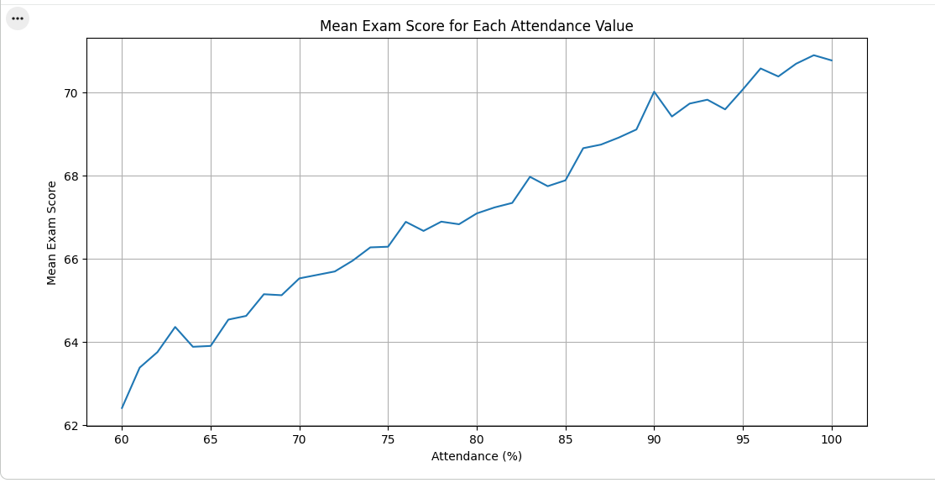
Line Plot: Mean Exam Score vs Attendance
The line chart demonstrates a steady upward trend, indicating that higher attendance consistently results in higher average exam scores. This strong positive relationship highlights that regular class participation is a crucial factor in achieving academic success.
Line Plot for Mean Exam Score vs Attendance

Slide 11
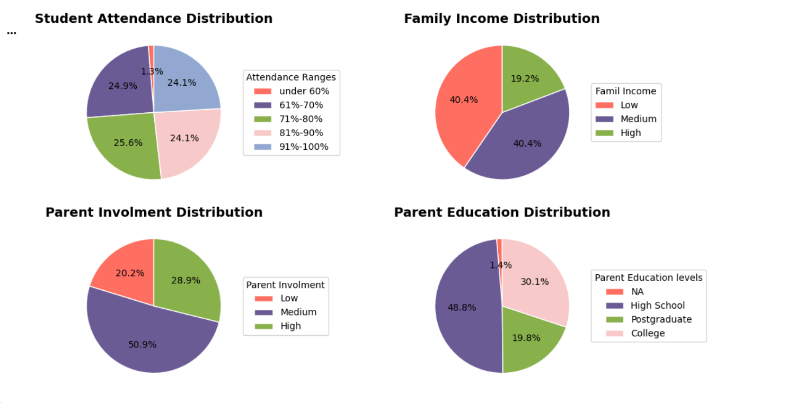
Pie Charts: Distribution for Student Attendance, Family Income, Parent Involvement, Parent Distribution
The school serves a predominantly low- to middle-income community with diverse parental education backgrounds, yet maintains strong student attendance and positive parental engagement. These figures reflect a resilient environment where family support and student participation remain high despite socioeconomic challenges.
Pie Charts for the distributions of some features

Slide 12

Detect Outliers
Outliers are data points that deviate significantly from the rest of the dataset, stemming from either data entry errors or genuine extreme variability. In educational contexts, these include both artificial anomalies, such as unrealistic study hours, and valid extremes like perfect scores or low attendance.
Common Outlier Detection Techniques
Interquartile Range (IQR) Method (Tukey’s method)
Z-score (Standard Score) Method
Visual Methods
Domain-Knowledge-Based Detection
Boxplots: Directly visualize the IQR bounds and flagged points.
Histograms and scatter plots: Help distinguish genuine extremes from errors.
Q1 = 25th percentile,
Q3 = 75th percentile
IQR = Q3 − Q1
Lower bound = Q1 − 1.5 × IQR
Upper bound = Q3 + 1.5 × IQR
Flags values where |z| = |(x − μ)/σ| > 3 (or sometimes > 2.5)
Example: Studying > 35 hours/week on a sustained basis is physiologically unrealistic for most students → likely error or exaggeration.

Slide 13
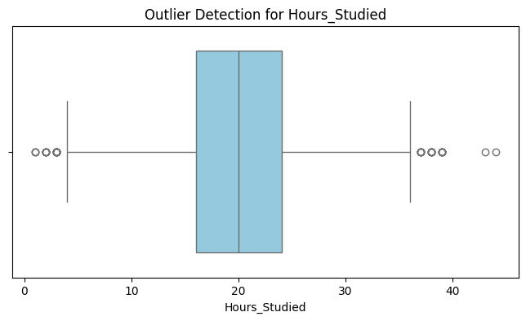
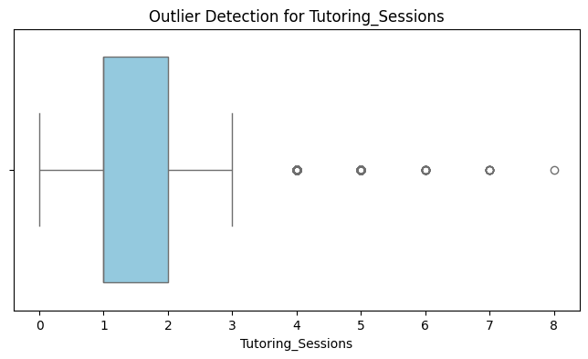
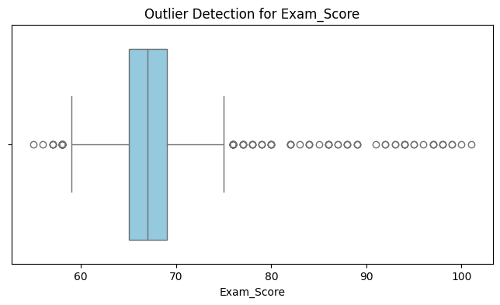
This section details the results of applying the Interquartile Range (IQR) method to detect outliers in Exam Scores, Hours Studied, and Tutoring Sessions. The analysis is supported by box plot visualizations and a table that characterizes the identified anomalies for each variable.

Slide 14

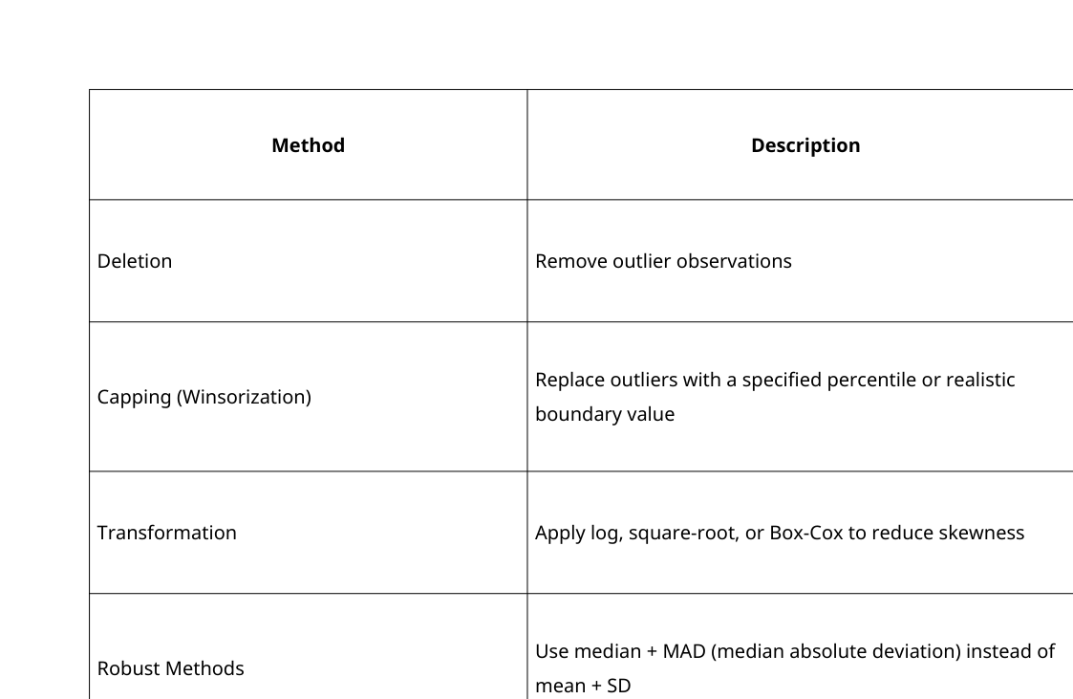
Handling Outliers

Slide 15
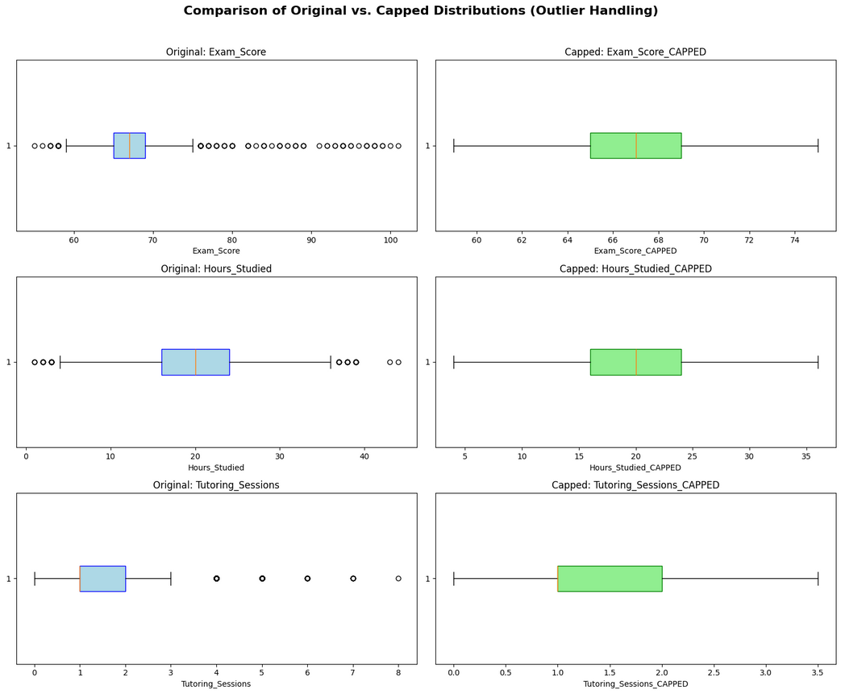

In order to handle the outliers in our report, we will calculate the Interquartile Range (IQR) boundaries for 'Exam_Score', 'Hours_Studied', and 'Tutoring_Sessions'. Outliers exceeding these bounds will be replaced by the nearest boundary value. This creates new, capped columns (e.g., Exam_Score_CAPPED), limiting the statistical influence of the extremes while keeping all data points.
Exam_Score: Originally had scores up to 101. We capped the upper limit at 75 (all scores > 75 were set to 75). → Maximum after capping = 75 (instead of 101).
Hours_Studied: Originally had unrealistic values up to 44. We capped at 36 hours/week. → Maximum after capping = 36 (instead of 44).
Tutoring_Sessions: Originally up to 8–10 sessions. We capped at 3 sessions. → Maximum after capping = 3.0 (instead of 8+).

Slide 16
General Observations About the Dataset
Socio-economically diverse but not extremely disadvantaged
Very high attendance culture overall
Strong representation of both low- and high-achieving students
Clear presence of “super performers” and a few extreme study/tutoring cases (handled via capping)
Excellent dataset for regression modeling due to zero missing values and rich mix of academic/behavioral/socio-economic features
A clean, synthetic but realistic dataset with moderate right-skewness in effort variables, a few genuine extreme performers, and perfect data quality — ideal for teaching EDA, correlation analysis, and regression while demonstrating the importance of careful outlier treatment.

Slide 17
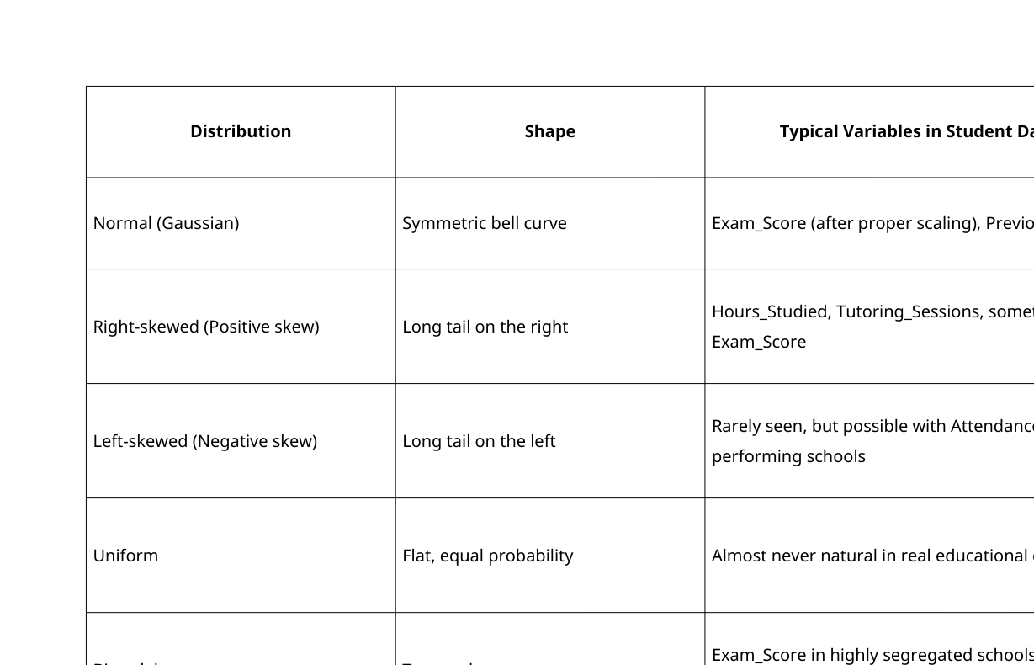
Probability Distribution Analysis
PROBABILITY DISTRIBUTION ANALYSIS EVALUATES THE SHAPE AND SPREAD OF VARIABLES TO DETERMINE IF THEY FOLLOW A NORMAL CURVE OR EXHIBIT SPECIFIC PATTERNS LIKE SKEWNESS. THIS ASSESSMENT IS CRITICAL FOR UNDERSTANDING THE DATA'S UNDERLYING BEHAVIOR AND ENSURING THE VALIDITY OF SUBSEQUENT STATISTICAL TESTS.

Slide 18
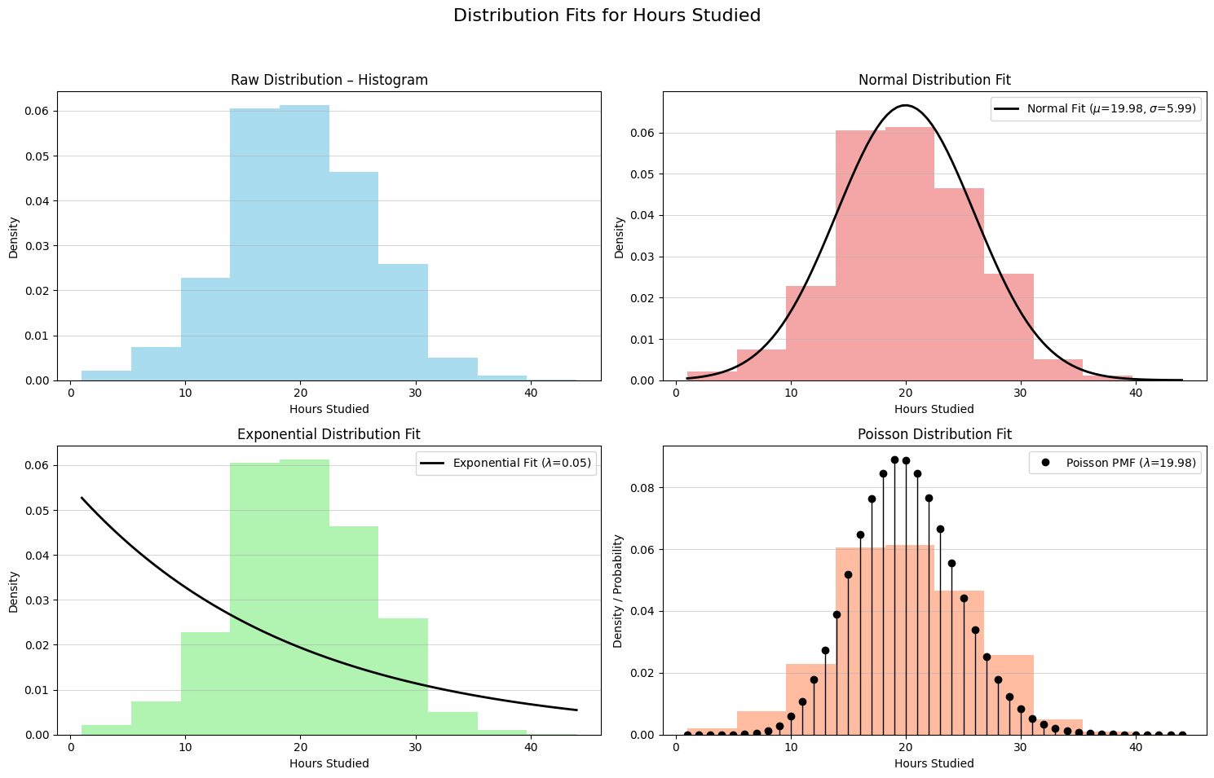

THIS SECTION UTILIZES COMPARATIVE VISUALIZATIONS TO ASSESS THE STATISTICAL DISTRIBUTION OF 'HOURS STUDIED' BY MATCHING RAW DATA AGAINST NORMAL, EXPONENTIAL, AND POISSON MODELS. IDENTIFYING THE BEST FIT IS ESSENTIAL FOR VALIDATING THE ASSUMPTIONS REQUIRED FOR ACCURATE STATISTICAL TESTING AND PREDICTIVE MODELING.
Distribution Fits for Hours_Studied

Slide 19
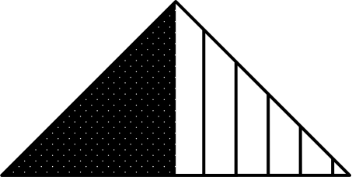
Hypothesis Testing
ANALYSIS OF VARIANCE (ANOVA)
Analysis of Variance (ANOVA) determines whether significant differences exist between the means of three or more independent groups by comparing the variation between them against the variation within them. This technique is widely used across research fields to analyze how categorical factors influence continuous outcomes. | How ANOVA Works ANOVA compares two types of variance: Variance between groups – caused by the factor of interest. Variance within groups – natural variation among individuals sharing the same condition. The test statistic is an F-ratio: F =Mean Square Between Groups/Mean Square Within Groups
Purpose of ANOVA ANOVA addresses the central question: Do all groups originate from populations with the same mean, or do some differ significantly? This is accomplished by partitioning total variability into: Between-group variability (explained by the factor), Within-group variability (unexplained or random variation). | Types of ANOVA One-Way ANOVA Two-Way ANOVA Repeated Measures ANOVA MANOVA (Multivariate ANOVA)
Assumptions of ANOVA | Independence of observations, all measurements are assumed to be independent. Normality, Scores within each group should be approximately normally distributed. Homogeneity of variances Group variances should be similar. Levene’s test is commonly used to assess this

Slide 20
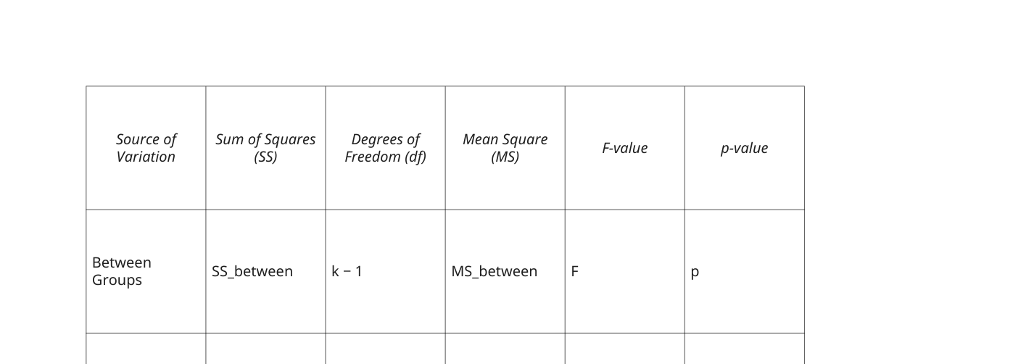
INTERPRETING ANOVA OUTPUT
When ANOVA Is Useful
A standard ANOVA table includes:
ANOVA is appropriate when:
The dependent variable is continuous.
One or more factors are categorical.
The goal is to evaluate group differences or interaction effects.
Common applications include:
Education (evaluating instructional methods),
Medicine (comparing treatment outcomes),
Psychology (assessing intervention effects),
Marketing (comparing responses across customer segments).
Interpretation:
p < 0.05 → reject the null hypothesis; group means differ significantly.
p ≥ 0.05 → fail to reject the null hypothesis; group means do not differ.
When significant differences are found, post hoc tests (e.g., Tukey, Bonferroni, Scheffé) identify which groups differ.

Slide 21
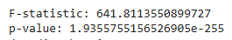
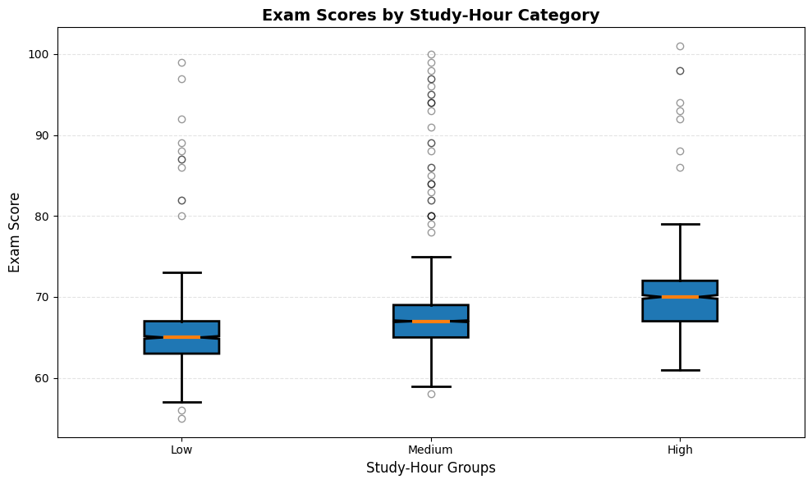
Research Question (Do students with Low, Medium, and High study hours have significantly different exam scores?)
We used One-Way ANOVA (Analysis of Variance) to test the hypothesis that Hours Studied (grouped into Low, Medium, and High levels) has a statistically significant effect on the mean Exam Score. This test confirms if the differences observed between the study groups are real or due to random chance.
Interpretation:
P-value is Extremely Small: Your P-Value is 1.935 × 10⁻²⁵⁵. This is essentially zero and is far smaller than the standard significance level of α = 0.05.
Decision:
Since the P-value < 0.05, you reject the Null Hypothesis (H₀).
The result confirms that the differences in mean Exam Scores across the ‘Low’, ‘Medium’, and ‘High’ study-hour groups are statistically significant. The high F-statistic (641.811) indicates that the variation between the groups is much larger than the variation within the groups.

Slide 22
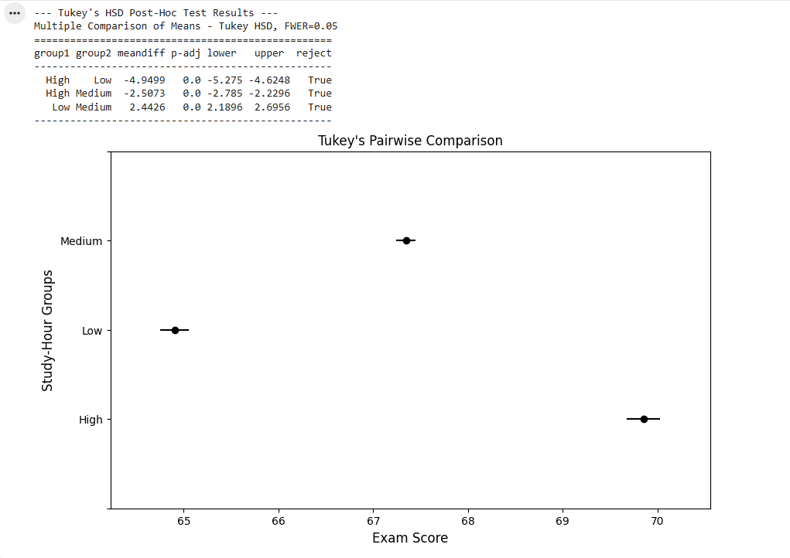
Post-Hoc Analysis of Study Effort
Following the rejection of the Null Hypothesis by the ANOVA, we execute Tukey's Honestly Significant Difference (HSD) test. This post-hoc analysis precisely identifies which specific study-hour groups ('Low', 'Medium', 'High') have statistically distinct mean Exam Scores.
The Tukey's HSD test reveals a highly significant P-Value (0.0) for all three pairwise comparisons. This conclusively proves that the mean Exam Scores for Low, Medium, and High study-hour groups are all statistically distinct from one another, reinforcing the direct relationship between increased study effort and academic achievement.

Slide 23
Summary for ANOVA
ANOVA provides a systematic method for analyzing mean differences across multiple groups by evaluating sources of variance. Through variations such as one-way, two-way, repeated measures, and MANOVA, it accommodates a range of research designs. It remains a foundational tool for statistical inference in studies requiring assessment of group differences and interaction effects.
Visualization (Box Plot) Analysis:
The box plot provides the practical context for this statistical finding: The median line and the entire box (IQR) are likely at distinctly different levels for the three groups. We can visually conclude that μ_Low < μ_Medium < μ_High. The visualization directly supports the finding that more study time leads to higher exam scores.
Visualization (Tukey's Pairwise Comparison)
The plot provides conclusive statistical evidence that all three study-hour groups ('Low', 'Medium', 'High') are distinct. The separation of the mean confidence intervals visually confirms that more study effort leads to a statistically significant increase in the mean exam score at every level.

Slide 24
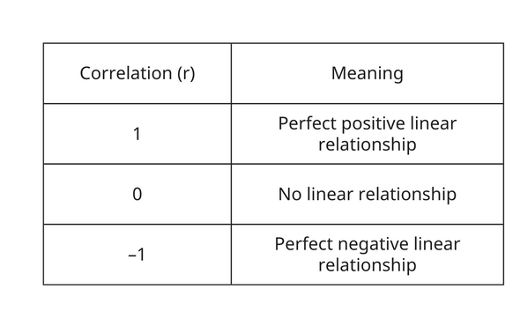
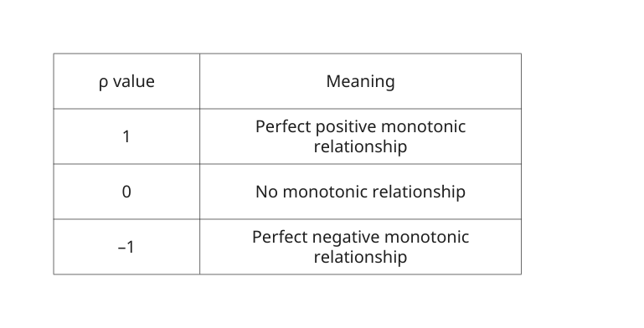
Correlation Analysis Between Variables
Pearson Correlation Coefficient (r)
Spearman Rank Correlation Coefficient (ρ)
Pearson correlation measures the strength and direction of a linear relationship between two continuous variables.
It quantifies:
How well two variables move together in a straight-line pattern.
Formula (conceptual)
Pearson is based on covariance, standardized by the variables’ standard deviations.
r = Cov(X, Y) / (σ_X * σ_Y)
Requirements (Assumptions)
Use Pearson when:
Variables are continuous
Relationship is linear
Both variables are normally distributed
No significant outliers
Interpretation
Spearman correlation measures the strength and direction of a monotonic relationship using ranked data.
A monotonic relationship means:
As one variable increases, the other consistently increases or decreases, but not necessarily at a constant rate.
When to use Spearman instead of Pearson
Use Spearman when:
Data is not normally distributed
Data is ordinal (ranked: 1st, 2nd, 3rd)
Relationship is non-linear but monotonic
There are outliers that affect Pearson
How it works
Convert data to ranks
Compute Pearson correlation on ranks
This makes Spearman robust to:
Skewed distributions
Outliers
Non-linear relationships
Interpretation

Slide 25
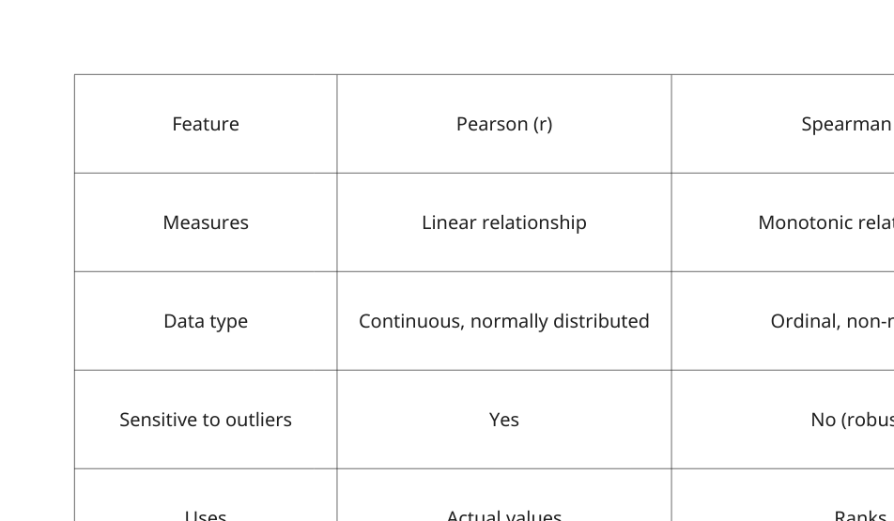
Pearson vs. Spearman — The Difference
Use Pearson if:
The relationship is linear
Data is continuous + normal
No major outliers
Use Spearman if:
Data is ranked or categorical
Relationship is monotonic (but not linear)
Data is skewed
Outliers exist
Summary
Pearson → Measures linear correlation, sensitive to outliers
Spearman → Measures rank-based monotonic correlation, robust
Both range from –1 to +1, with 0 indicating no relationship

Slide 26
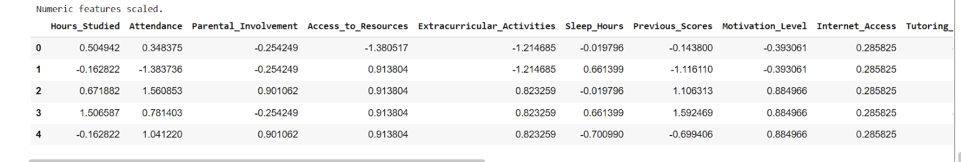
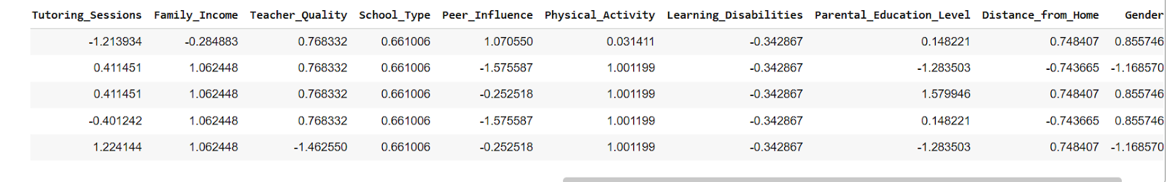
Calculating the chosen correlation coefficient between variables
Output after calculating the correlation coefficient between variables
The analysis reveals that student effort—specifically study hours and attendance—is the primary driver of exam success, significantly outweighing socioeconomic background and external resources. This highlights that interventions focused on study habits and engagement will yield the greatest improvements in academic outcomes.

Slide 27
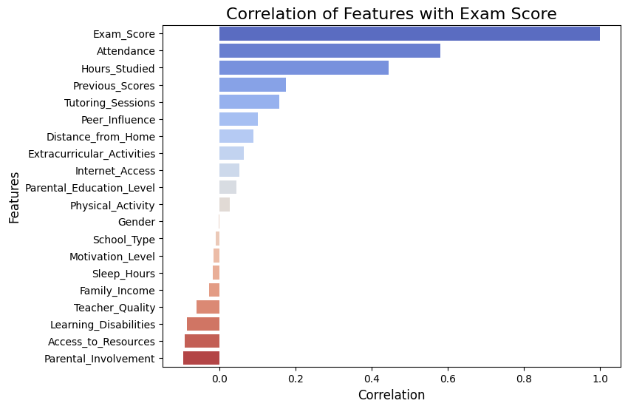
Visualizations to show relationships between variables
The visualization identifies Attendance and Hours Studied as the dominant predictors of exam scores, far exceeding the influence of socioeconomic factors or external resources. This confirms that active student engagement and effort are the primary drivers of academic success.
Correlation of features with Exam Score using Bar Plot

Slide 28
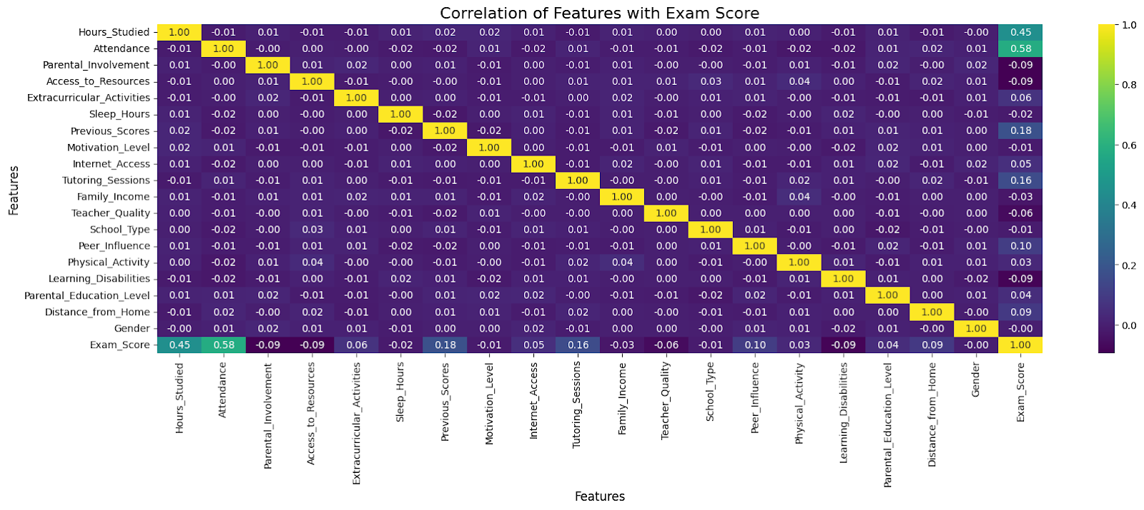
Visualizations to show relationships between variables
This Heatmap Shows That Attendance and hours studied light up more strongly against Exam Score. Then, Other variables appear mostly dark, reflecting weak correlations.
Correlation of features with Exam Score using Heatmap

Slide 29
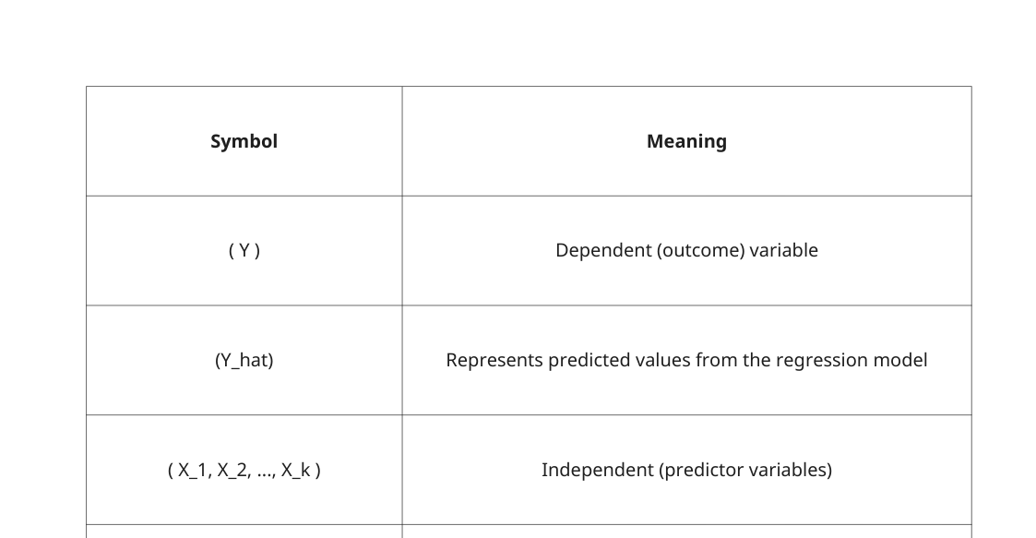
Multiple Linear Regression
Theory of Multiple Linear Regression
What Is Multiple Linear Regression?
The Regression Equation
Multiple Linear Regression is a statistical technique used to model the relationship between one dependent variable (Y) and two or more independent variables (X₁, X₂, X₃, …, Xₖ).
The purpose is to:
Predict the value of Y
Understand how each independent variable affects Y
Measure the strength of the combined effect of all predictors
It generalizes simple linear regression (1 predictor) to multiple predictors.
Y = B1X1 + B2X2+ ... +BkXk + a
How the Model Is Estimated (Least Squares Method)
MLR coefficients are estimated using the Ordinary Least Squares (OLS) method.
OLS chooses β₀, β₁, ..., βₖ to minimize:
∑(𝑌𝑖−𝑌𝑖_hat)^2
This is the sum of squared residuals (SSR).
The optimal regression line is the one that fits the data with the least total error.

Slide 30
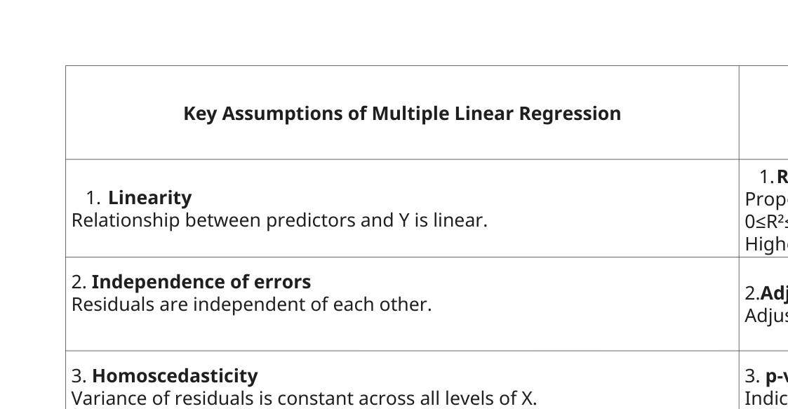
Multiple Linear Regression
Theory of Multiple Linear Regression

Slide 31
Practice of Multiple Linear Regression
Now that data cleaning, encoding, and outlier treatment are complete, we move to the final modeling and diagnostic phase. In this section we:
Built a complete preprocessing pipeline using ColumnTransformer (median imputation + scaling for numeric features; mode imputation + one-hot encoding for categorical features).
Applied the pipeline to obtain a fully numeric dataset ready for both scikit-learn and statsmodels.
Performed train-test split (80/20).
Trained a Linear Regression model and evaluate performance with R², Adjusted R², MAE, MSE, and RMSE on both train and test sets.
Fit an OLS model (statsmodels) on the full processed data to obtain detailed coefficient statistics and p-values.
Checked for multicollinearity using Variance Inflation Factor (VIF).
Performed comprehensive residual diagnostics: Breusch-Pagan test (heteroscedasticity), Shapiro-Wilk test (normality), and visual plots (Residuals vs Predicted, Q-Q plot, histogram).

Slide 32
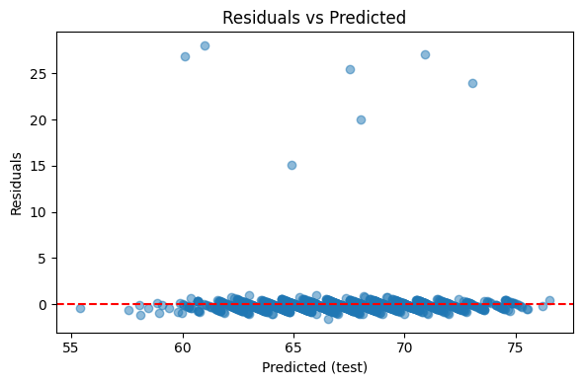
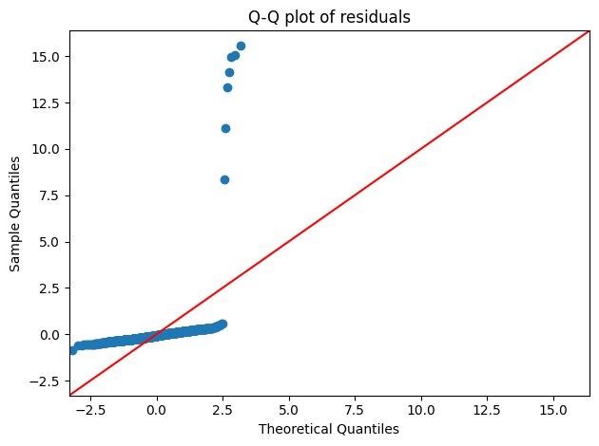
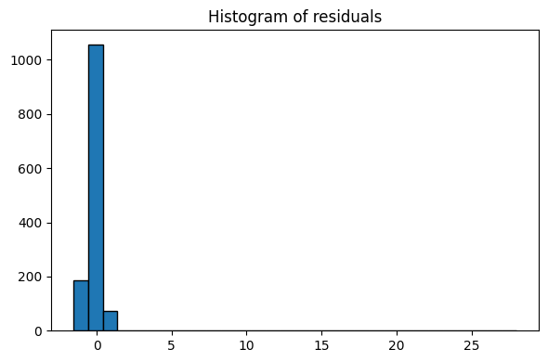
Practice of Multiple Linear Regression

Slide 33
Practice of Multiple Linear Regression
Model Performance & Conclusion The final linear regression model performs very well and is highly reliable:
Predictive Power: R² = 0.727 (full data), with test-set R² = 0.77 and RMSE ≈ 1.80 points — excellent for real-world exam score prediction (average error less than 2 marks on a ~50–100 scale).
Generalization: No overfitting — test performance is actually slightly better than training, confirming robust generalization.
Key Drivers (all highly significant, p < 0.001 except two non-significant variables):
Attendance (+2.30 points) – strongest predictor
Hours_Studied (+1.77 points) – second strongest
Previous_Scores and Tutoring_Sessions – strong positive effects
Low Parental Involvement, Low Access to Resources, and Low Family Income each cost students ~1–2 points on average.
Model Diagnostics – All assumptions satisfactorily met:
No heteroscedasticity (Breusch-Pagan p = 0.89 → fail to reject homoscedasticity)
Mild multicollinearity only in Internet_Access_Yes (VIF ≈ 10), all others < 6 → acceptable
Residuals show heavy tails (Shapiro-Wilk rejects normality due to extreme performers), but this is expected in real educational data and does not invalidate inference given the large sample and visual randomness in residual plots.
The residual diagnostic plots collectively confirm a well-behaved and reliable linear regression model:
The Residuals vs Predicted plot shows random scatter tightly clustered around the zero line with no funnel shape, indicating homoscedasticity and no systematic bias across the prediction range.
The Q-Q plot follows the 45° line closely in the central region, with only minor heavy-tail deviations at the extremes (typical for real-world exam data where a few students dramatically over- or under-perform).
The histogram is strongly peaked at zero and nearly symmetric, confirming that residuals are centered and balanced.

Slide 34
Conclusion
Schools and policymakers seeking to improve student outcomes should prioritize interventions that directly increase attendance, study time, and access to tutoring — especially for students with lower prior scores. Resources invested in these high-impact areas will yield significantly greater returns than broad efforts to change family income, parental involvement, or teacher quality alone.
In summary, student success is primarily determined by what students do, not where they come from. This evidence-based insight provides a clear, actionable roadmap for equitable and effective educational improvement.

